Slide 1





Slide 2








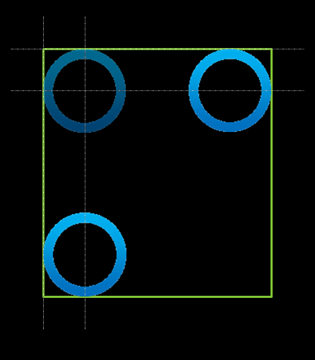




This style?
Full Circle Solutions
or
Integrated Solutions
This style?

Slide 3

Integrated Solutions

Slide 4



Full Circle Solutions

Slide 5
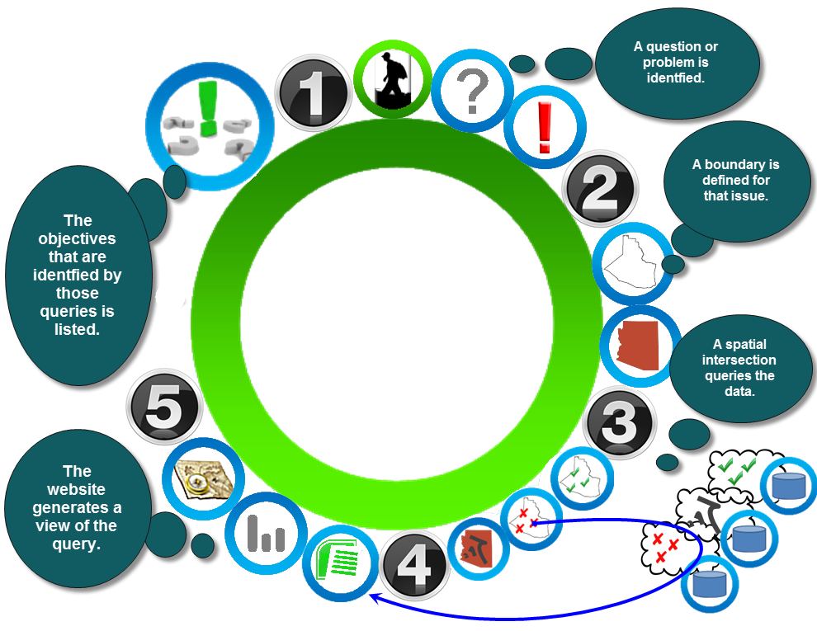
Should I do something
Like this?

Slide 6
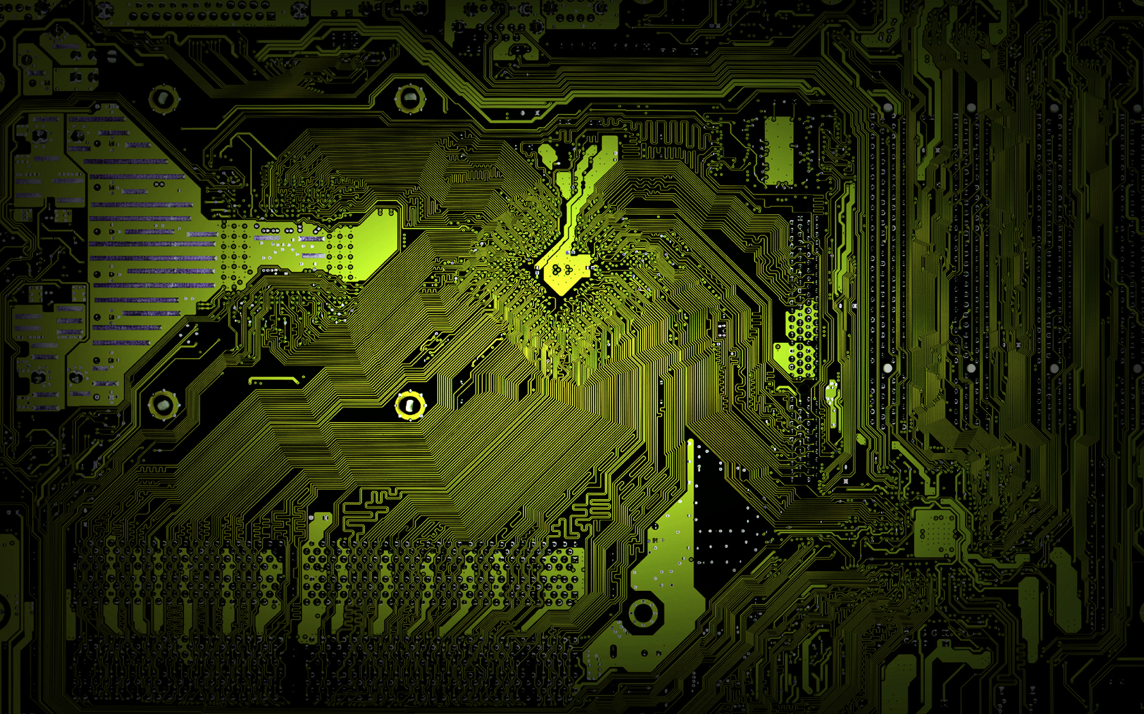
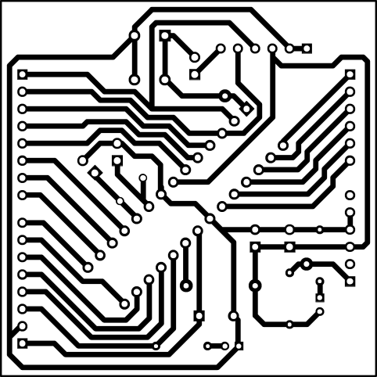
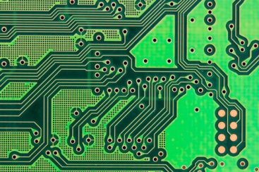
Thinking about one of these for the flow diagram

